Slide 1


Vivekananda College of Engineering & Technology
[A Unit of Vivekananda Vidyavardhaka Sangha Puttur®]
Affiliated to Visvesvaraya Technological University
Approved by AICTE New Delhi & Recognised by Govt of Karnataka
DEPARTMENT OF COMPUTER SCIENCE AND ENGINEERING ( DATA SCIENCE )
Project Phase I Synopsis Presentation on
Web-Based Automatic Timetable Scheduler for Schools & Colleges
Presented by : Gaurav G Alva
4VP22CD019
Harshit M Naik
4VP22CD022
Prapthi J P
4VP22CD037
Supreetha N S
4VP22CD058
Guided by : Prof. Chaithanya D

Slide 2
Problem Identification

Slide 3
Existing solution

Slide 4
Proposed Solution

Slide 5
User requirements
System Requirements:
PC should have at least 4 GB of RAM,
Windows 7 and upwards.
Python version least 3.8 or above.
SQLite default database.
Internet access.
Project Components:
Identifying the requirements of the Certificate generation process.
Details about the events, workshops or conferences.
Customization of templates as per the event requirements.

Slide 6
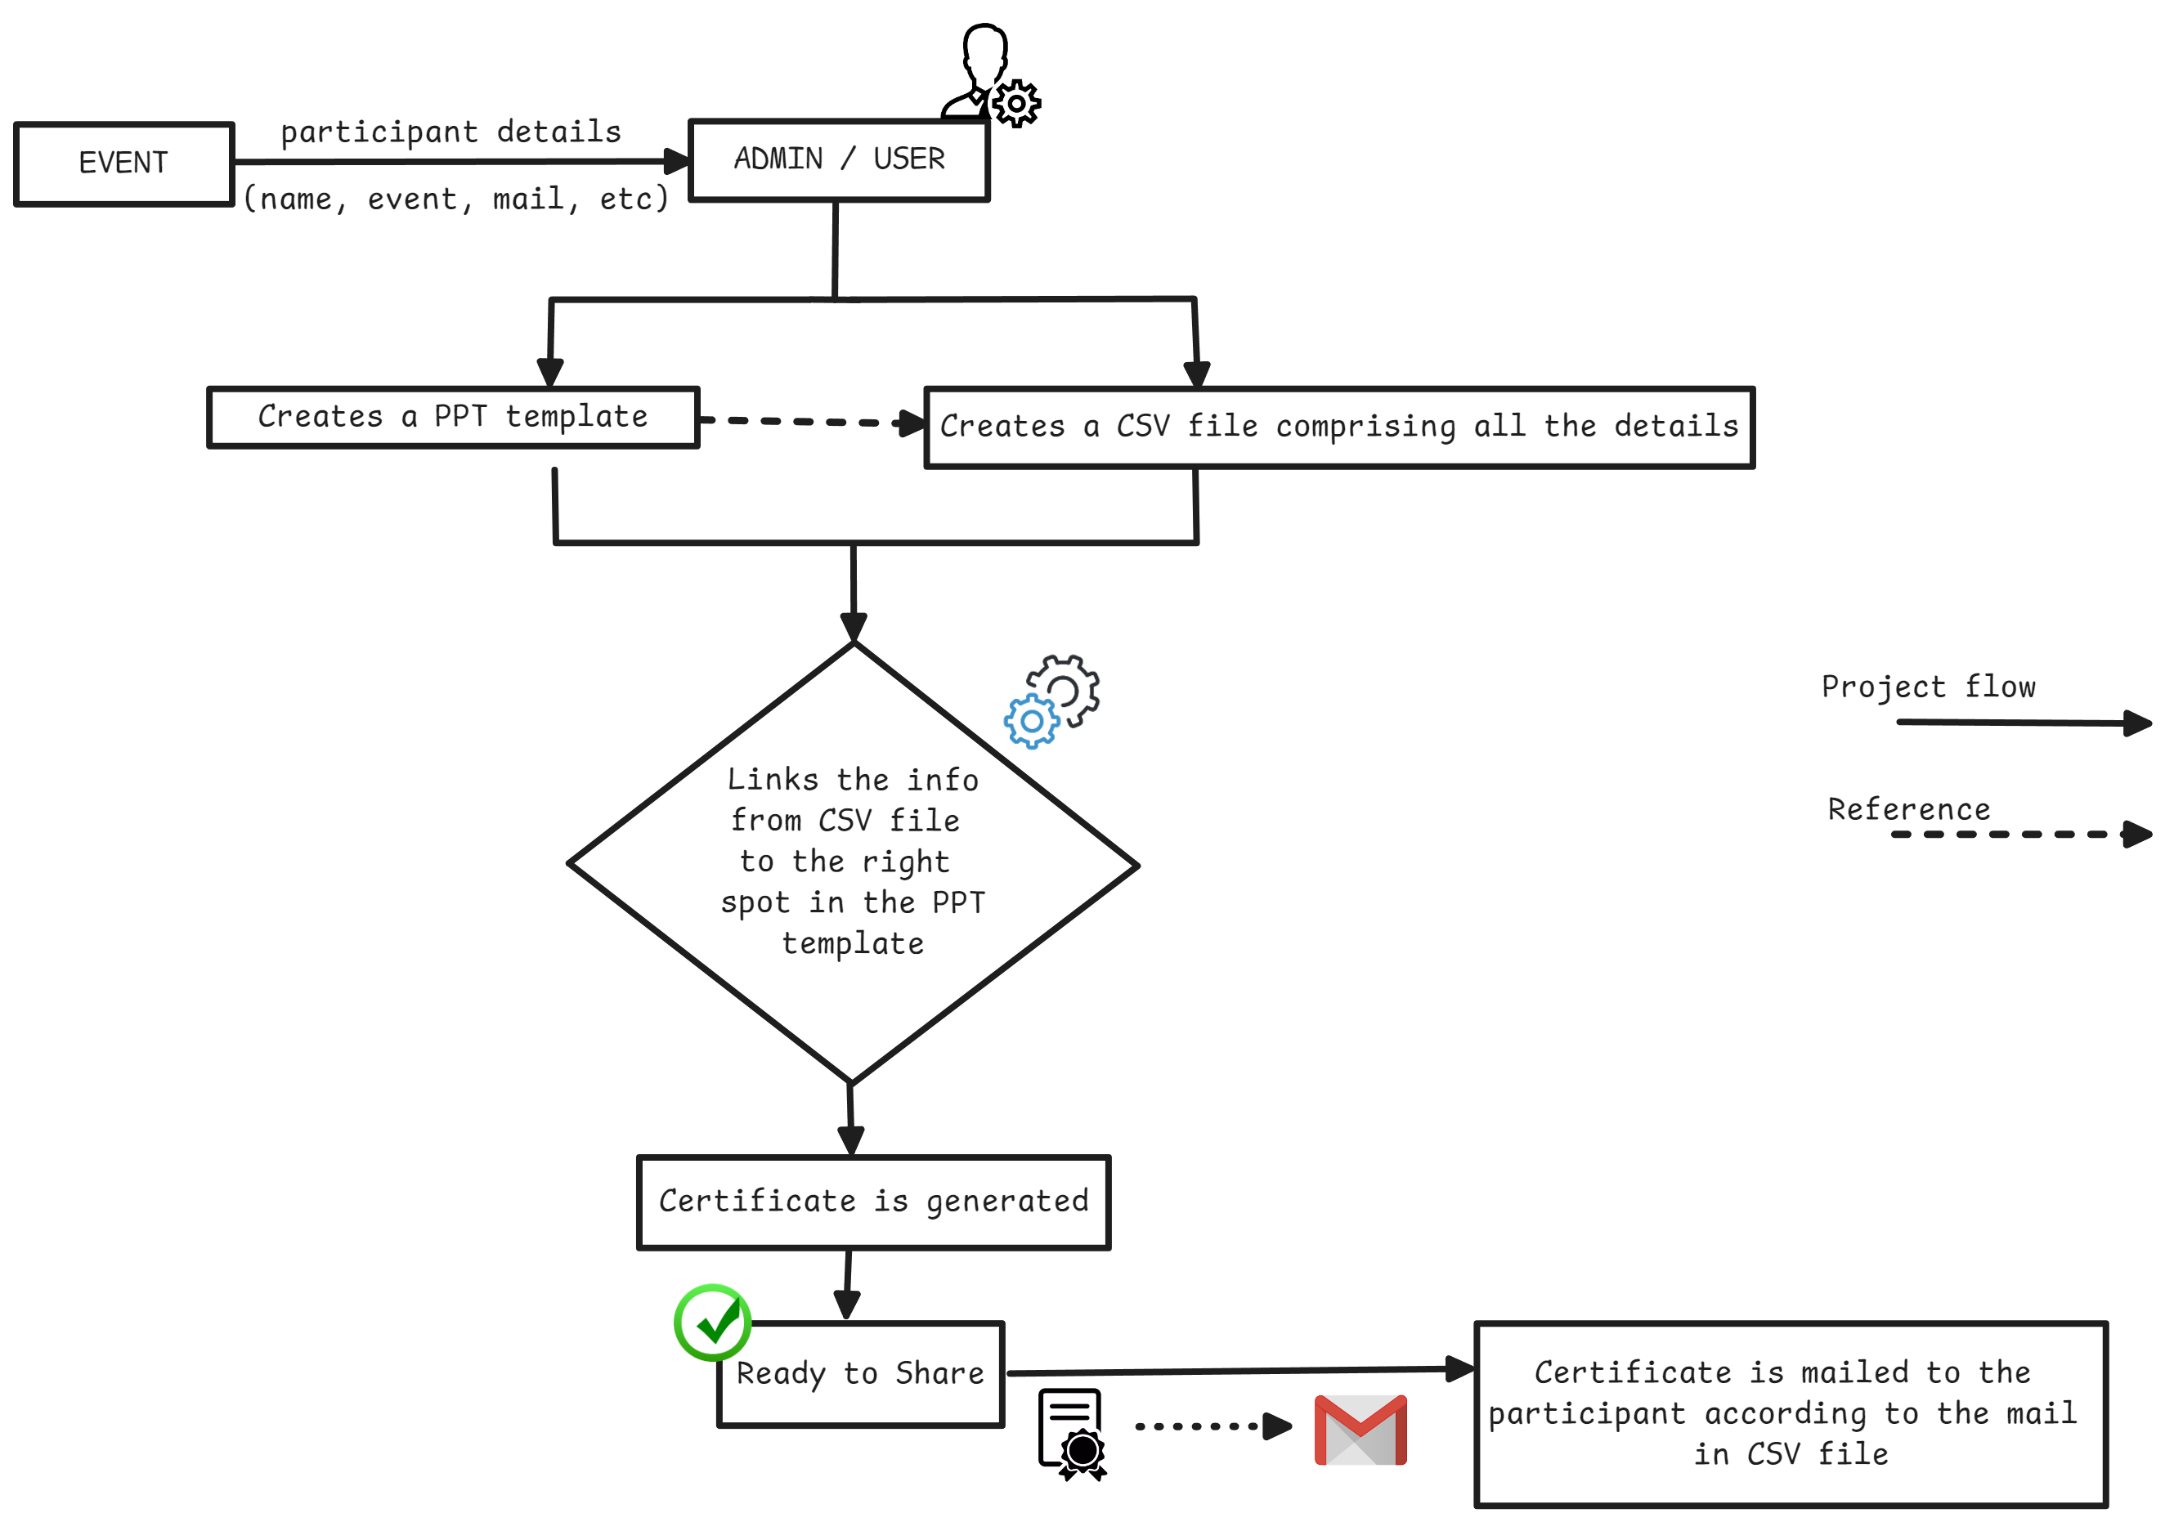
Methodology

Slide 7
Methodology
Design and Development:
User friendly interface for uploading PPT templates and CSV data.
Using basic HTML, CSS and Django and other PyPi libraries for development ( ppt2pdf, pymail, excel2csv, etc ).
Integration of Email for automated distribution(*Google Workspace Account).
Deployment:
Deploying the System in the Server / Cloud platform (AWS or Google Cloud).
GitHub for managing the Code.

Slide 8
Conclusion

Slide 9
References

